Slide 1
Decision Tree Classification
Author: Maoxi Xu
Professor: Erik Grimmelmann

Slide 2
Overview
A decision tree is a type of supervised machine learning used to categorize or make predictions based on how a previous set of questions were answered. The model is a form of supervised learning, meaning that the model is trained and tested on a set of data that contains the desired categorization.

Slide 3
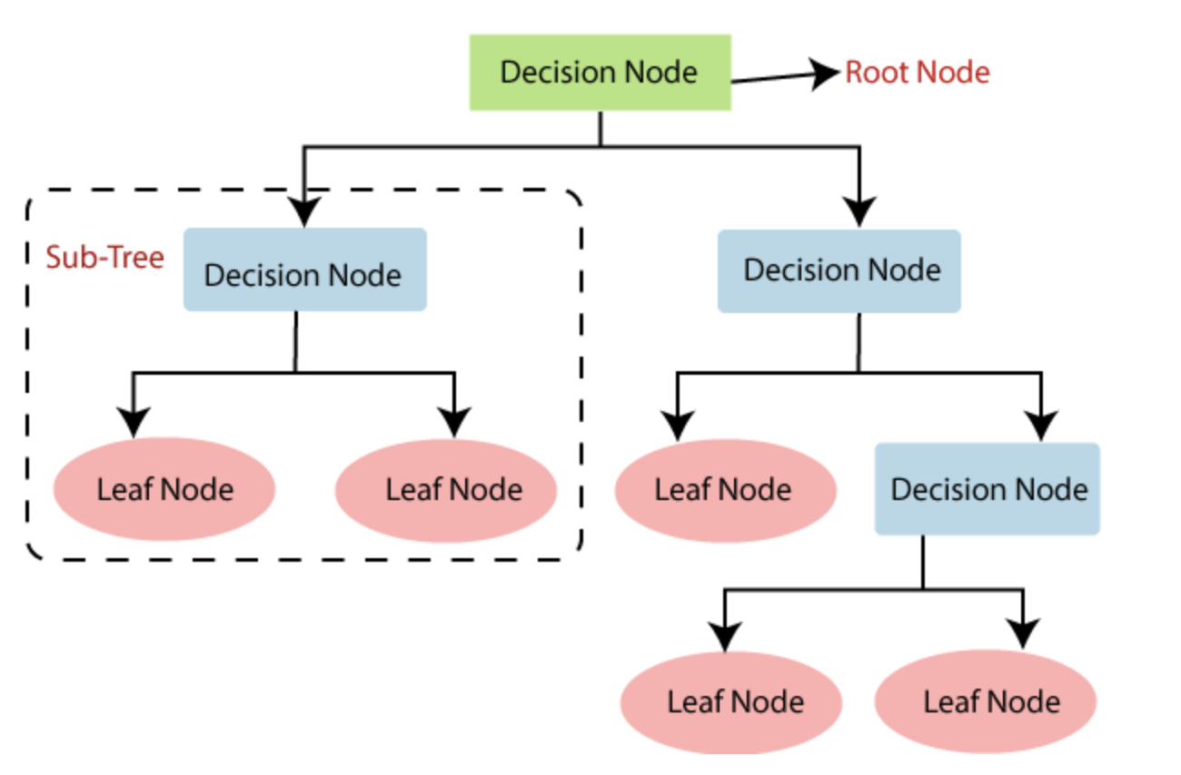
Model structure
Begin at the root node and evaluate the feature indicated by the node.
Proceed along the tree branch that corresponds to the value (or range of values) of the feature for the given instance.
Continue this sequence with the subtree rooted at the next node, repeating until all features have been assessed.

Slide 4
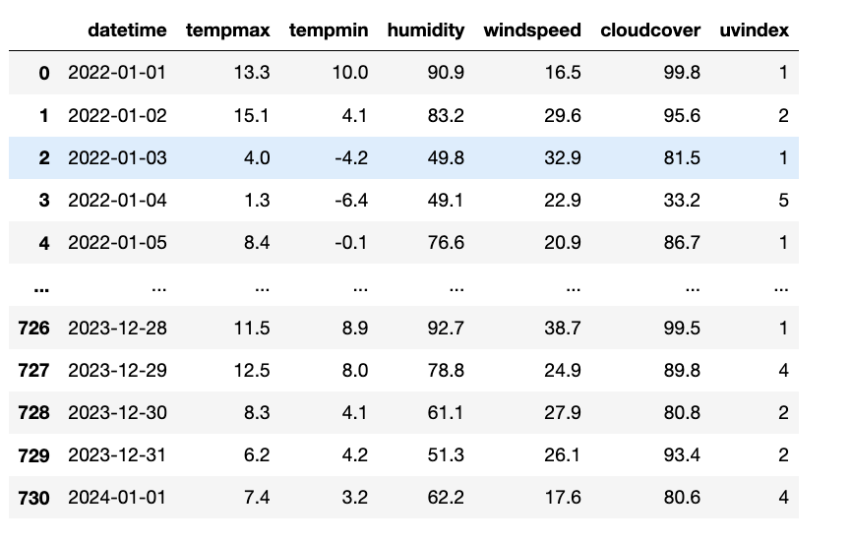
Data Description and Preparation
Dataset:
The data set is derived from daily weather measurements in Queens, New York, collected by the Weather Data Center over the past two years. It captures a variety of weather metrics, including extreme temperatures, humidity, wind speed, and cloud cover...
Feature Selection
For predicting high precipitation days, we focused on six key features: maximum and minimum temperatures, humidity, wind speed, cloud cover, and UV index

Slide 5
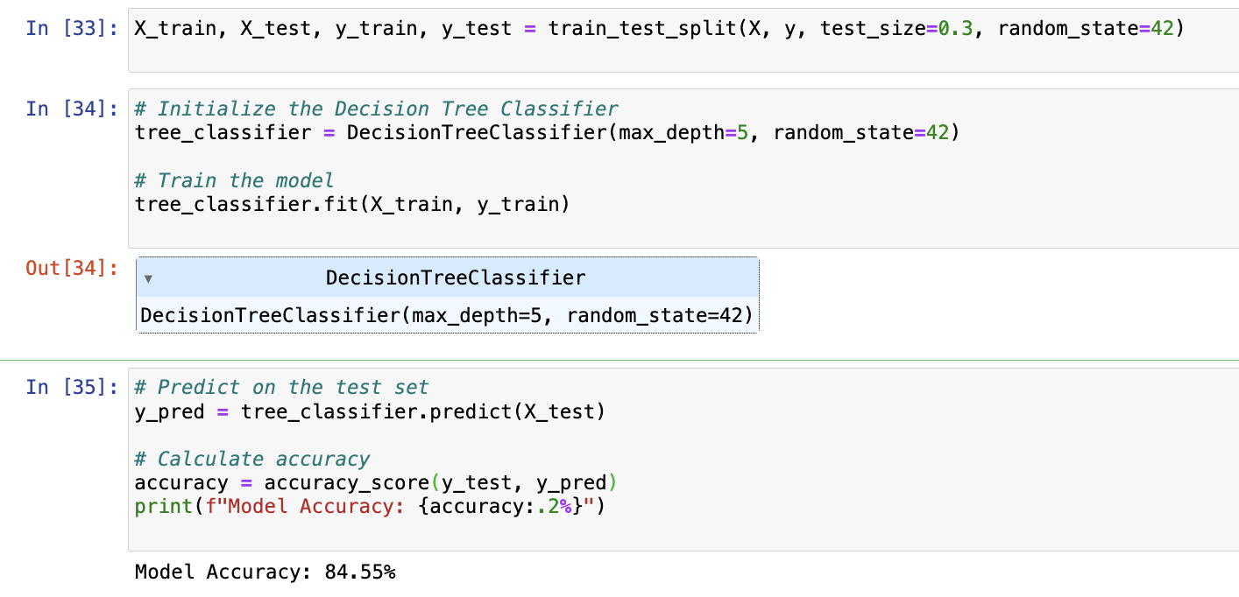
Model Training and Prediction
Model Parameters:
For the decision tree, setting the maximum depth to 5 helps prevent the model from becoming overly complex and memorizing the training data, a common problem known as overfitting.
Training Process:
By splitting the data into a 70-30 train-test ratio, we ensure that we have enough data to train our model while still having a substantial amount left over to test its performance and validate our findings accurately.
Accuracy Discussion:
An accuracy of 84.55% is quite high for a weather prediction model, indicating that our decision tree classifier performs robustly in predicting high precipitation days. This level of accuracy suggests that the model can be a reliable tool in weather forecasting applications, helping to prepare better for precipitation-heavy days.

Slide 6

Conclusion and Future work
Conclusion :
We successfully developed a decision tree model that accurately predicts days with high precipitation, proving its usefulness in weather prediction.
Future Directions:
To further enhance our model, we may explore additional weather variables and advanced modeling techniques. This will improve our predictions and potentially allow for real-time weather forecasting.

Slide 7

Thank you !

